Slide 1


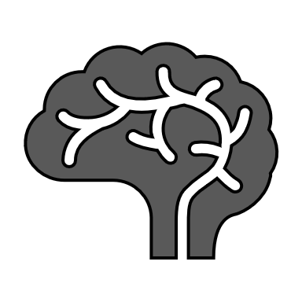



The representation of brain networks for emotion categories
Cachupa
Rohit Misra
Iosif Lytras
Iraj Ahangari
Gürkan Sinan Yaşar
Dong Chenjie
TA
Mentor
Bindu Kumari (Course)
Tanya Upadhyay (Project)
Maria Eckstein
Margarita Zachariou

Slide 2
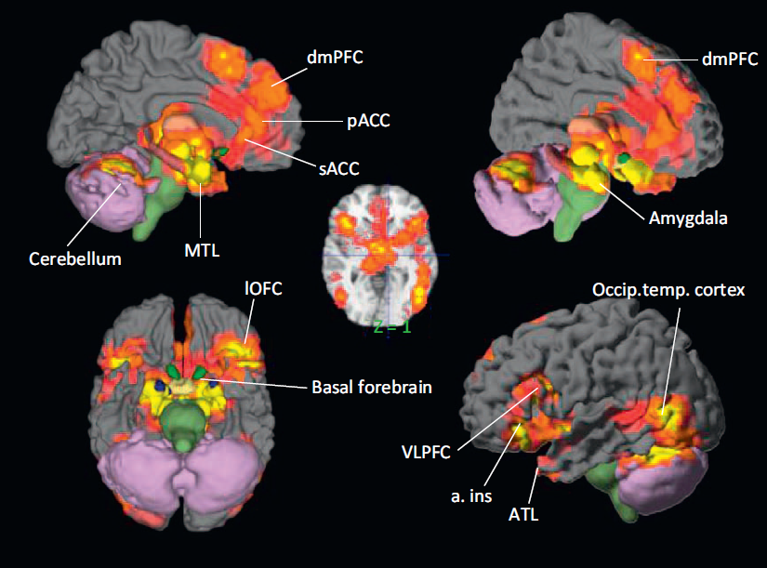
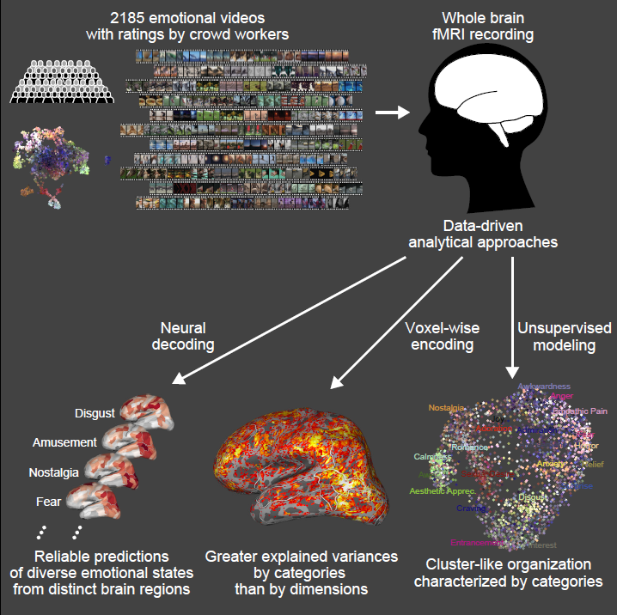
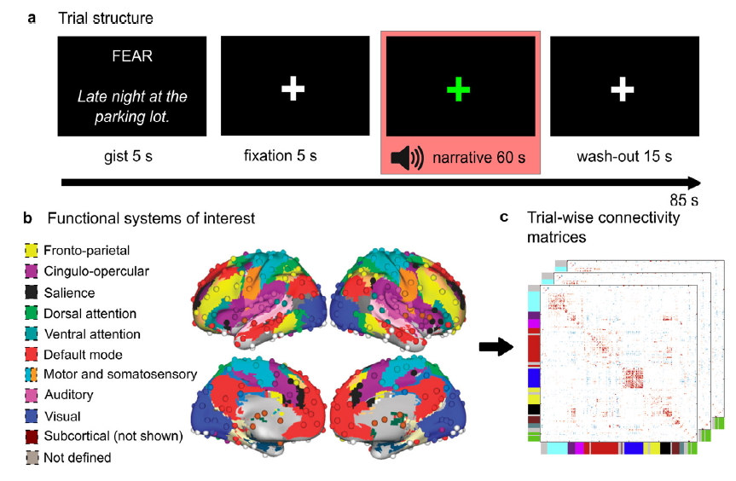
Background
Gürkan Sinan Yaşar
Emotion is critical for survival and formed by various quantitative and qualitative components.
Emotion categories with high dimensional features are represented in distributed brain areas and can be predicted by functional connectivity networks (FCN) .
Lisa & Barrett,2012
Tomoyasu et al., 2020
Saarimäki et al., 2022
Aim: revealing the representation of emotion categorizes from the perspective of FCN using fMRI and unsupervised machine learning.

Slide 3
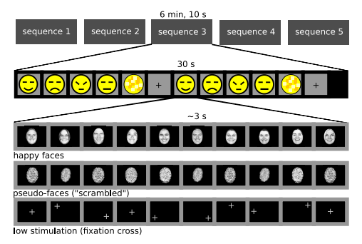
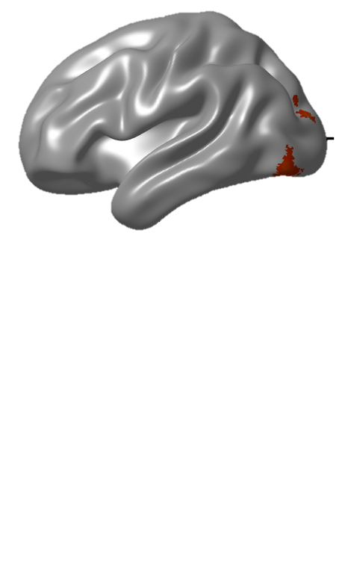
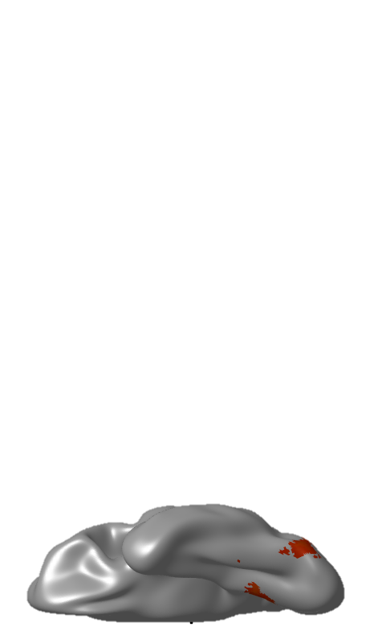
The present study: datasets
Dong Chenjie
Datasets: Emotion Category and Face Perception Task
Optimized for Multivariate Pattern Analysis
David & Barrios, 2021
Details
fMRI dataset
N=16 (8 women)
Conditions: happy, sad, angry , neutral, & scramble face
Block design : 5 runs, 10 blocks per condition, 10 pictures per block
Gender identification task
face > scramble face
Verify the datasets with classical analysis
p<0.005, cluster size >100

Slide 4
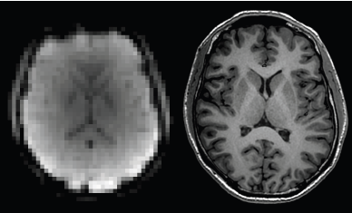
Pipeline
Rohit Misra
After preprocessing the fMRI data
Calculated the emotion-specific FCN for 48 regions of interest (ROI)
Unsupervised model was used to cluster the distribution of emotion-related FCN
A representative network for each cluster was obtained by averaging the cluster correlation matrices.
Analyzed the FNC using theoretic analysis
Preprocessing
Parcellation
Stimuli based segmentation of ROI serials
Functional connectivity for each segment
Clustering of connectivity matrix
Representative networks
Graph theoretic analysis
PCA

Slide 5
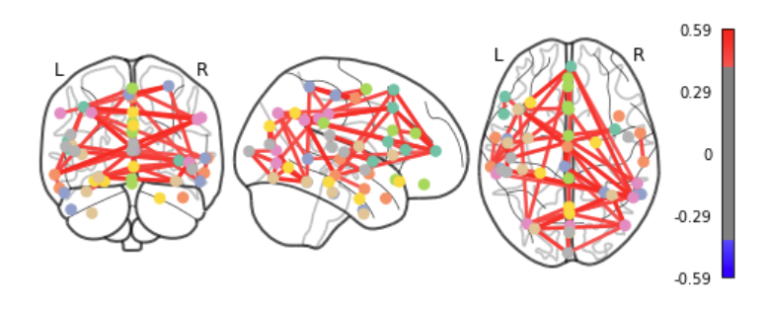
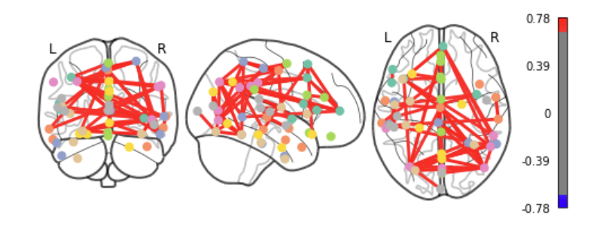
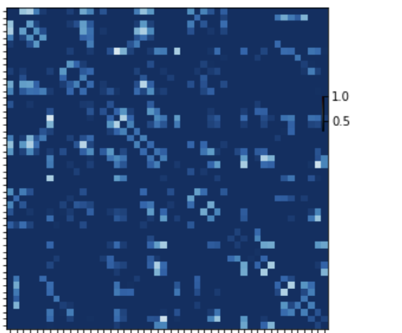
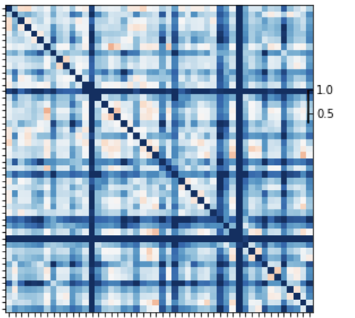
Results
Iosif Lytras
Two emotional network clusters with different connectivity characteristic were found.
network-1(local network)
network-2(global network)

Slide 6
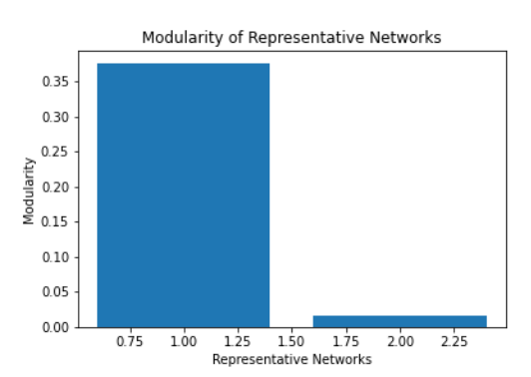
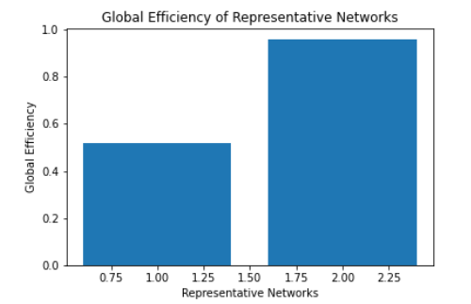
Results and Conclusion
Iraj Ahangari
Network-1 showed higher modularity and lower global efficiency than network-2.
Network- 1 may be related to immediate emotion recognition involving less widespread brain connectivity.
Network - 2 may be related to subjective evaluation of emotion involving integration of information from various brain regions.
The representative networks provide an intuitive and effective model to capture the representation of emotion categories in the brain.

Slide 7




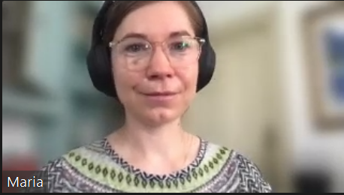












Everyone loves coding !?
سپاسگزارم
感谢
Teşekkürler
Ευχαριστώ
Thanks
धन्यवाद
धन्यवाद

